Slide 1

FAST FACTS ABOUT…
SUSTAINABLE NATURAL RUBBER

Slide 2
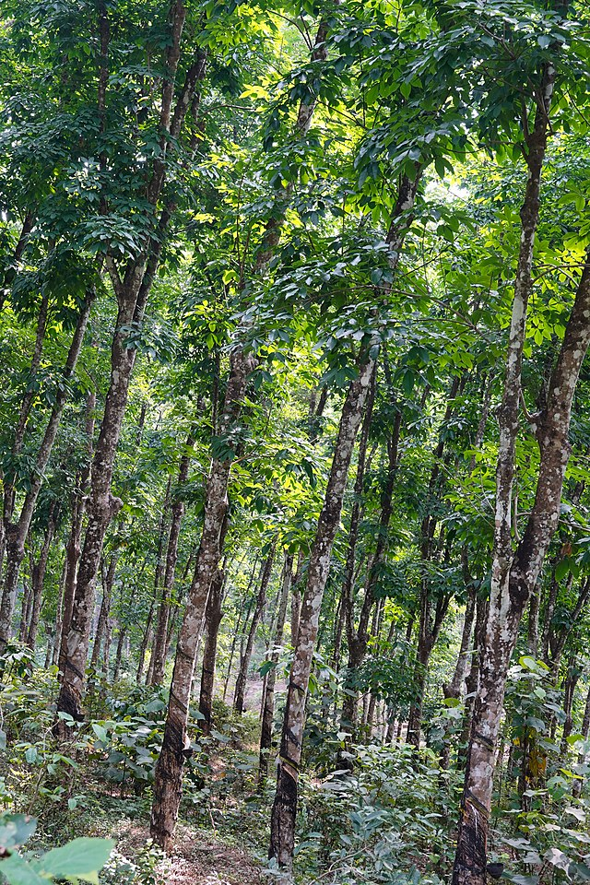

Natural rubber is derived from the sap of certain plants, predominantly the Hevea Brasiliensis tree.
WHAT IS NATURAL RUBBER?
Hevea Brasiliensis tree
Photo Credit: Timothy A. Consalves
Source: https://www.ustires.org/advocacy/sustainable-natural-rubber

Slide 3
Natural rubber is critical to manufacturing safe and durable tires.
WHAT ARE THE BENEFITS TO THE TIRE INDUSTRY?
Durability
Natural rubber is critical for all tires as it serves to provide durability. Certain tire performance can only be achieved through the use of natural rubber.
Performance
Commercial and military aircraft tire treads are almost completely made from natural rubber because synthetic rubber cannot perform in this application.
Unique Properties
Natural rubber is also the main component in heavy duty truck and bus tire treads due to its unique properties.
Source: https://www.ustires.org/advocacy/sustainable-natural-rubber

Slide 4
Over 90% of current natural rubber supply originates in Southeast Asia.
The rubber tree is very susceptible to disease.
Loss of this supply chain from Asia would exacerbate supply chain issues in the U.S., affecting tire production and defense capabilities.
WHY DOES THE U.S. NEED A DOMESTIC SUPPLY?
Source: https://www.ustires.org/advocacy/sustainable-natural-rubber

Slide 5
The two most promising natural rubber producing plants to use in developing a domestic supply of natural rubber are guayule and TKS (dandelion).
ALTERNATIVES TO HEVEA NATURAL RUBBER
Domestically Available
Both plants can be grown in different parts of the U.S.
Performance
Both plants provide equivalent performance to Hevea natural rubber in tires.
Economical
Both plants contain valuable co-products which serve to reduce the cost of rubber.
Source: https://www.ustires.org/advocacy/sustainable-natural-rubber

Slide 6
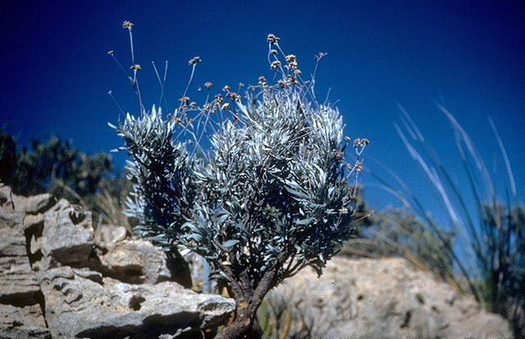
Incentivize the needed investments to help farmers adapt to planting rubber-producing crops.
Scale commercial processing facilities to extract the rubber and co-products from the plants.
Increase investment into public research of other domestic alternatives to Hevea natural rubbers.
HOW TO DEVELOP A DOMESTIC SUPPLY
Guayule shrub
Source: https://www.ustires.org/advocacy/sustainable-natural-rubber

Slide 7
LEARN MORE ABOUT SUSTAINABLE NATURAL RUBBER
ON USTIRES.ORG.

