Slide 1

FAST FACTS ABOUT…
TIRE SAFETY THROUGH INNOVATION

Slide 2


Tires are safer and deliver better performance than ever, driven by continuous advances in tire design, materials and engineering that support road safety, mobility and performance.
Proper maintenance helps tires perform as designed and supports safer travel. Worn-out tires are three times more likely to be involved in a crash than tires with sufficient tread depth.
SAFETY BY DESIGN
Source: https://www.ustires.org/national-tire-safety-week/fact-sheet-nstw

Slide 3

Highly technical advancements help improve traction, reduce rolling resistance and support better performance in changing road and weather conditions.
These innovations help motorists get where they need to go safely, efficiently and reliably. Proper tire maintenance, including rotation, balance and alignment, can extend average tire life by 4,700 miles.
ADVANCEMENTS IN ACTION
Source: https://www.ustires.org/national-tire-safety-week/fact-sheet-nstw /fact-sheet-nstw

Slide 4
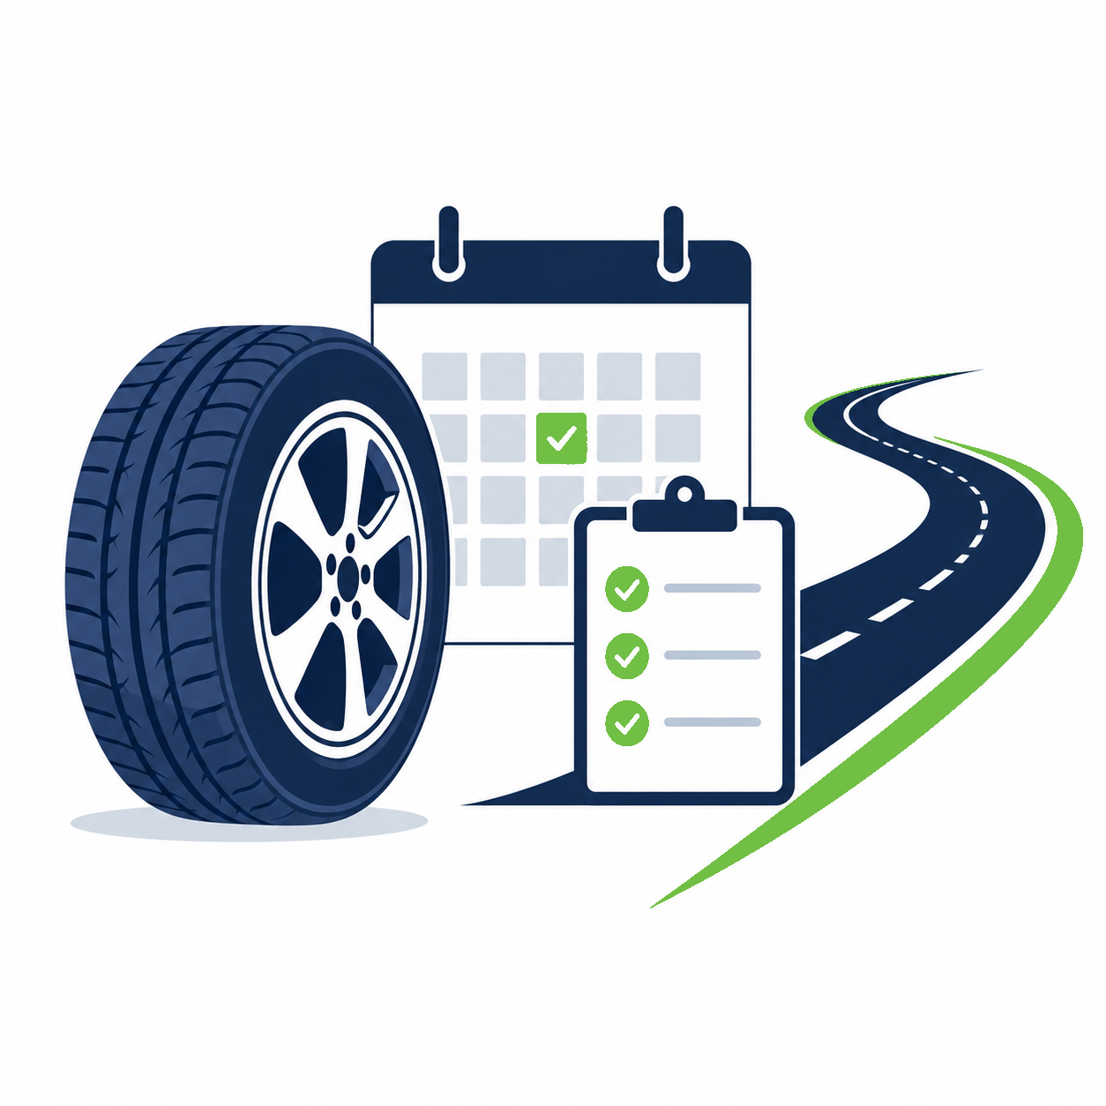
With U.S. drivers logging a record 3.324 trillion miles in 2025, tire safety and maintenance remain essential to keeping motorists road ready.
Manufacturers design and build tires to travel tens of thousands of miles before service, and simple monthly checks and regular service by a tire professional support safety, service life and mobility.
MAINTAINING MOBILITY
Source: https://www.ustires.org/national-tire-safety-week/fact-sheet-nstw

Slide 5
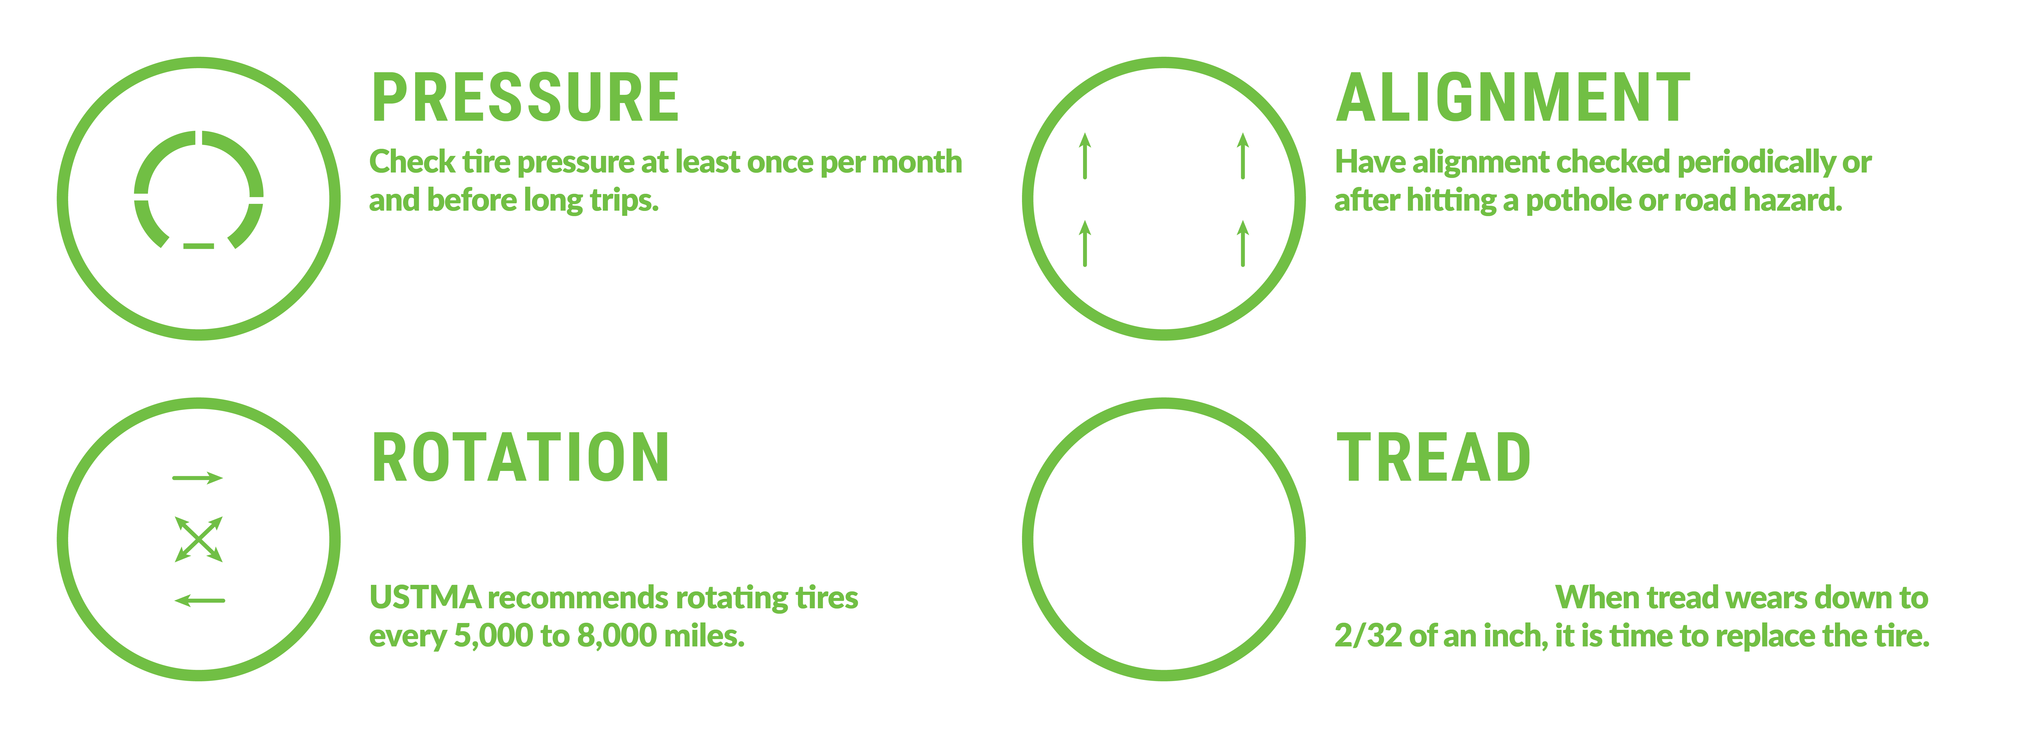
PLAY YOUR P.A.R.T.
Source: https://www.ustires.org/national-tire-safety-week/fact-sheet-nstw /fact-sheet-nstw

Slide 6

With 69% of Americans likely to take an overnight road trip more than 100 miles from home, regular tire care remains an essential part of preparing for longer drives.
Before hitting the road, motorists should check tire pressure, alignment, rotation and tread to help stay road ready.
ROAD READY STARTS WITH TIRE CARE
Source: https://www.ustires.org/national-tire-safety-week/fact-sheet-nstw

Slide 7
LEARN MORE ABOUT TIRE SAFETY
AT USTIRES.ORG/SAFETY.

