Slide 1

FAST FACTS ABOUT… TIRE DERIVED AGGREGATE (TDA)

Slide 2


Tire derived aggregate (TDA) refers to shredded or chipped scrap tires repurposed as construction material. It is a resource-efficient alternative to traditional materials, often used as a cost-effective solution.
WHAT IS TDA?
Source: State of Knowledge Report on Tire Derived Aggregate (TDA)

Slide 3
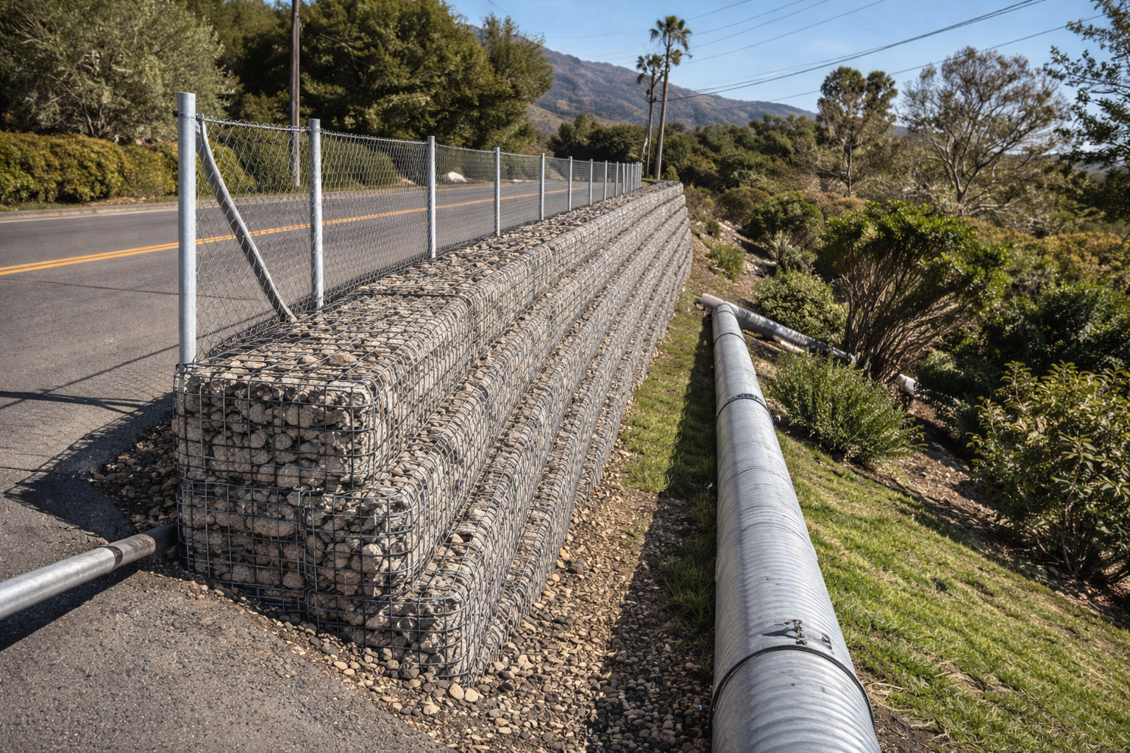
TDA’s lightweight, high-permeability and high-shear-strength properties make it well suited for drainage layers, embankments, retaining walls and vibration mitigation.
Diverse Applications
These properties allow engineers to solve common geotechnical challenges while reducing loads, improving drainage and enhancing long-term performance.
Source: State of Knowledge Report on Tire Derived Aggregate (TDA)

Slide 4
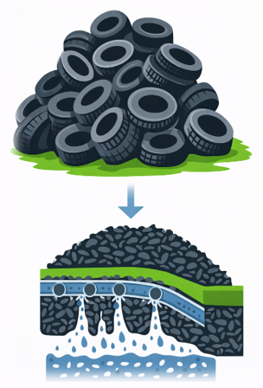
TDA provides a beneficial use for approximately 330 million end-of-life tires generated annually in North America. TDA offers a scalable, practical solution to one of the largest and most persistent waste streams in North America.
Renewing Old Tires’ Purpose
Source: State of Knowledge Report on Tire Derived Aggregate (TDA)

Slide 5

TDA can be safely used in civil engineering projects without posing risks to groundwater, aquatic life or human health.
SAFETY FIELD-TESTED & VERIFIED
Source: State of Knowledge Report on Tire Derived Aggregate (TDA)

Slide 6
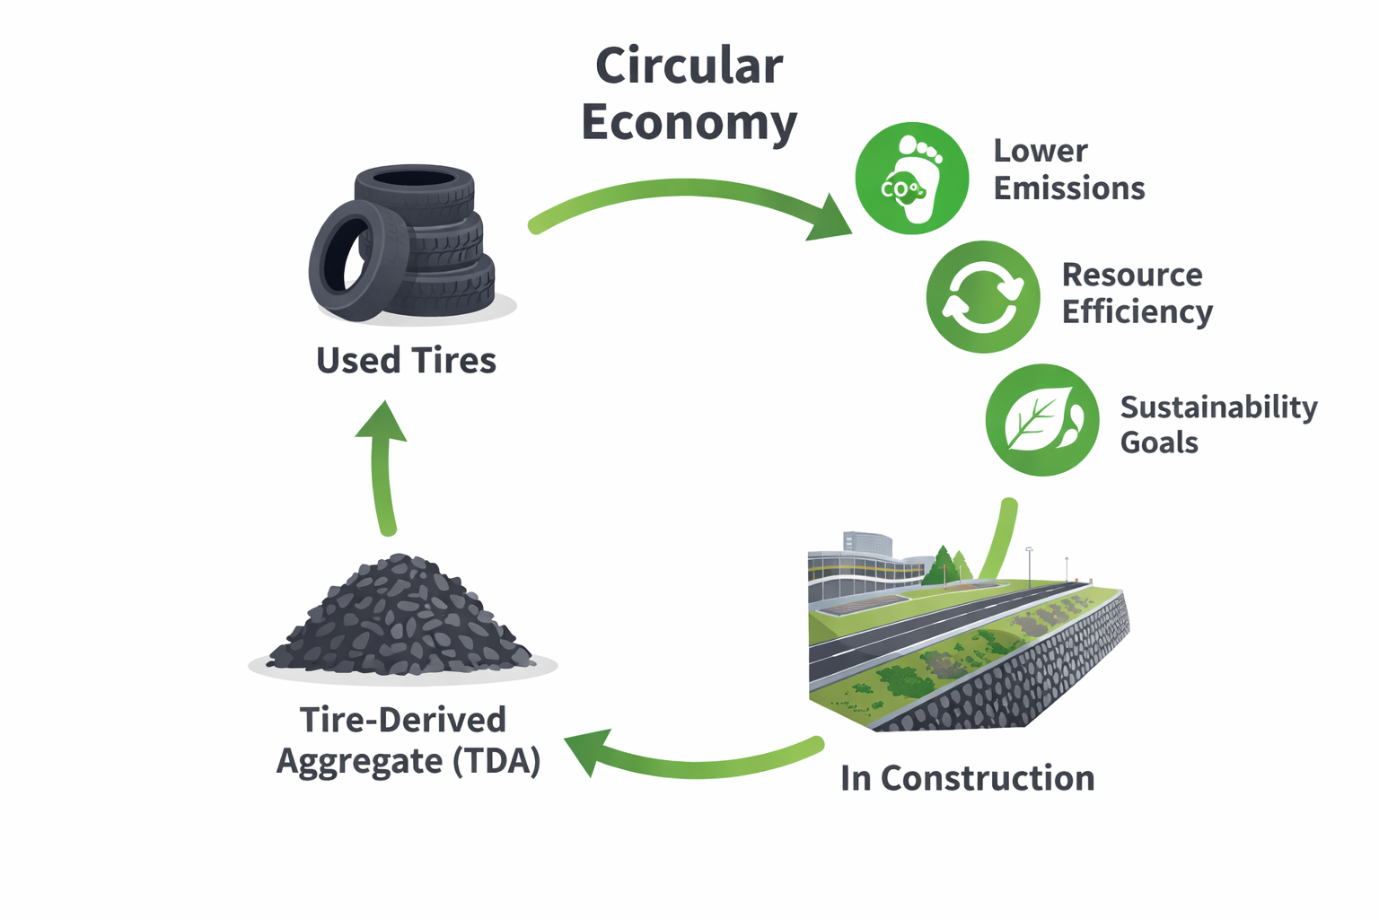
Key Benefits:
TDA DRIVES CIRCULAR Economy
Supports circular-economy construction practices
Reduces reliance on virgin aggregates
Lowers greenhouse gas emissions
Market & Industry Impact:
Boosts project efficiency and resource use
Strengthens market competitiveness
Advances sustainability goals
Source: State of Knowledge Report on Tire Derived Aggregate (TDA)

Slide 7
LEARN MORE ABOUT TDA ON USTIRES.ORG.

