Slide 1

FAST FACTS ABOUT…
VEHICLE DATA ACCESS

Slide 2
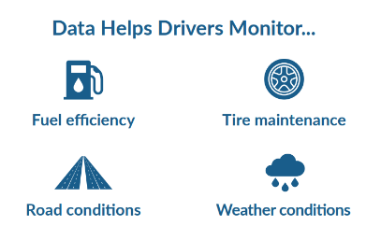

THE FUTURE OF MOBILITY IS CHANGING RAPIDLY WITH MAJOR TRANSFORMATIONS:
Advanced Drive-Assistance Systems (ADAS)
Autonomous driving
Vehicle Electrification
Shift to asset usage
Vehicle-to-Vehicle, Vehicle-to-Infrastructure Connectivity
Source: USTMA_Vehicle_Data_Access_Policy_Statement

Slide 3
Tires are the only part of a vehicle that connect with the road and can link information about the road and the vehicle to provide key data to the driver.
Access to this data can increase the speed of innovation of connected and autonomous technologies in the United States.
Access can also improve safety and sustainability through information generated in applications for drivers.
HOW IN-VEHICLE DATA ADVANCES THE FUTURE OF MOBILITY
Source: USTMA_Vehicle_Data_Access_Policy_Statement

Slide 4
Data access is critical to improve vehicle safety and sustainability.
WHAT ARE THE BENEFITS OF ACCESS TO
IN-VEHICLE DATA?
Reduced Energy Usage
Increased Safety
Reduced Emissions
Increased Vehicle Uptime
Reduced Traffic Congestion
Source: USTMA_Vehicle_Data_Access_Policy_Statement

Slide 5
Information generated by the tire and paired with vehicle data:
EXAMPLES OF IN-VEHICLE DATA BENEFITS
Notifies the driver of events or vehicle maintenance issues
Monitors and provides real-time road and weather condition data to the driver
Predicts tire wear, damage and when tires need to be rotated or replaced
Provides real-time data about vehicle loading
Reminds the driver of safety checks and service intervals
Source: USTMA_Vehicle_Data_Access_Policy_Statement

Slide 6
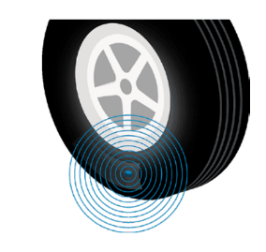
Industry standardization to support privacy and cybersecurity.
Opt-in option for consumers to choose if a service can access their vehicle’s data.
Diagnostic tools accessible to enable diagnosis and repair, as well as preventative service and maintenance.
HOW TO ENSURE PRIVACY AND EQUITY
Integrated tire sensors, chips and tags wirelessly transmit real-time information
Source: USTMA_Vehicle_Data_Access_Policy_Statement

Slide 7
LEARN MORE ABOUT
VEHICLE DATA ACCESS
ON USTIRES.ORG.

