Slide 1

FAST FACTS ABOUT…
TIRE RETREADING

Slide 2
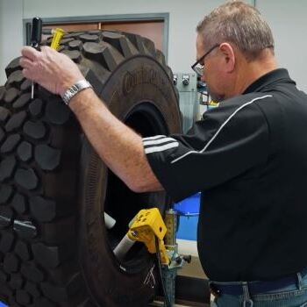

Employs over 51,000 American workers.
Largest remanufacturing sector in the U.S.
Supports more than 268,000 jobs across the broader U.S. tire industry.
Retreads are a nearly 100% domestically produced product manufactured by small independent businesses.
AMERICA DEPENDS ON THE RETREAD SECTOR
Source: The State of Retread Tires in the United States & Canada – 2024 Addendum

Slide 3
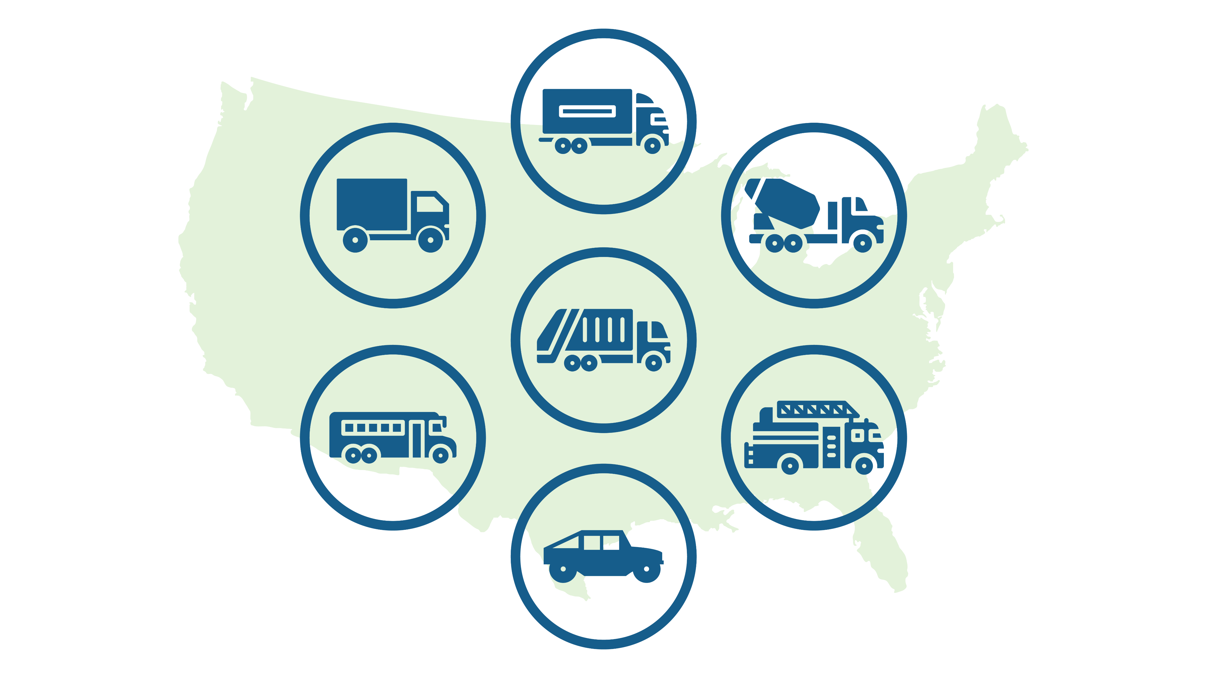
Approximately 15 million tires are retreaded annually in the U.S, including nearly 44% of commercial truck tires in the U.S. and Canada. Common retread users:
WHO DEPENDS ON RETREAD?
Long-Haul Carriers
Package Delivery Fleets
Waste Fleets
U.S. Military
School Buses
Government Fleets
Source: The State of Retread Tires in the United States & Canada – 2024 Addendum

Slide 4
Compared to new tires, retreaded tires:
ECONOMIC DRIVER & ENVIRONMENTAL SOLUTION
Use 15 gallons less oil and 90 lbs. less total material per tire
Save the U.S. and Canada about 215 million gallons of oil per year
Remove 1.4 billion lbs. per year from the waste stream
Reduce CO₂ emissions by 24%
Source: The State of Retread Tires in the United States & Canada – 2024 Addendum

Slide 5
To help build a more sustainable environment, each retreaded tire reduces:
REDUCING CO₂ EMISSIONS IN A TIRE’S LIFE CYCLE
Energy Consumption
CO₂ Emissions
Raw Material Usage
Tire Disposal Challenges
Source: The State of Retread Tires in the United States & Canada – 2024 Addendum

Slide 6
Alarmingly, there has been a 50% decrease in the number of retread facilities in the U.S. over the past 21 years.
The number of domestic tire retreading facilities continues to drop due in part to growing imports of foreign alternatives for new tires, which are 65% less likely to be retreaded because of their design and construction.
This trend threatens the U.S. job market and undermines efforts to build robust tire recycling programs, given that about 65% of foreign tires are less likely to be retreaded.
THE RETREAD FACILITY DECLINE
Source: The State of Retread Tires in the United States & Canada – 2024 Addendum

Slide 7
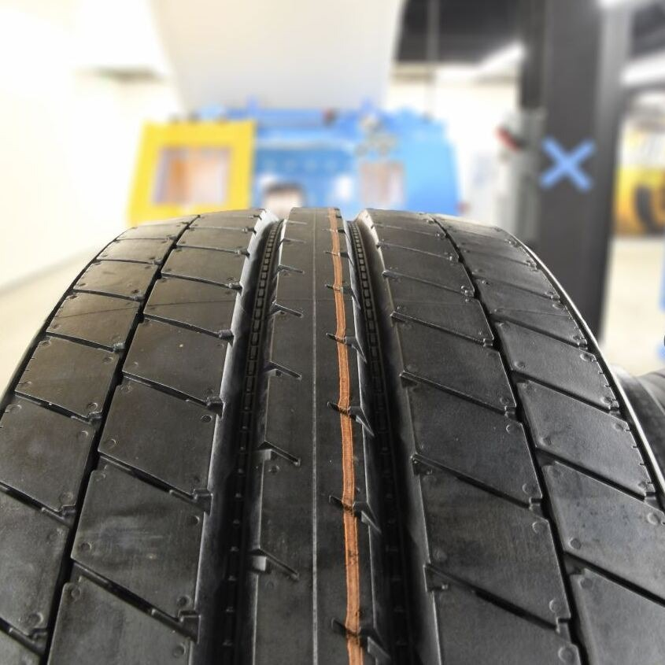
HOW TO BOOST TIRE RETREADING
Prioritize the expansion of sustainable and circular infrastructure solutions for tires.
Incentivize investments in retreaded commercial tires.
Level the playing field for U.S. tire companies.
Create domestic manufacturing jobs for production of retreaded tires.
Shift the business model back in favor of retreading.
Source: The State of Retread Tires in the United States & Canada – 2024 Addendum

Slide 8
LEARN MORE ABOUT
TIRE RETREADING
ON USTIRES.ORG.

