Slide 1

FAST FACTS ABOUT…
END-OF-LIFE TIRE MANAGEMENT

Slide 2
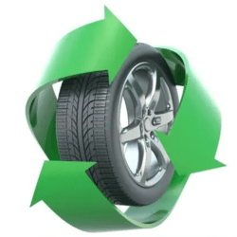

How Far We’ve Come: Tires are now one of the most recycled and reclaimed consumer products in the U.S.
Where We Are Now: 79% tires go to beneficial end-use markets, an 8% increase from 2021.
Our Ultimate Goal: 100% of end-of-life tires (ELTs) enter sustainable and circular end use markets.
TIRES AND THE CIRCULAR ECONOMY IN 2023
Source: 2023 End-of-Life Tire Management Report

Slide 3
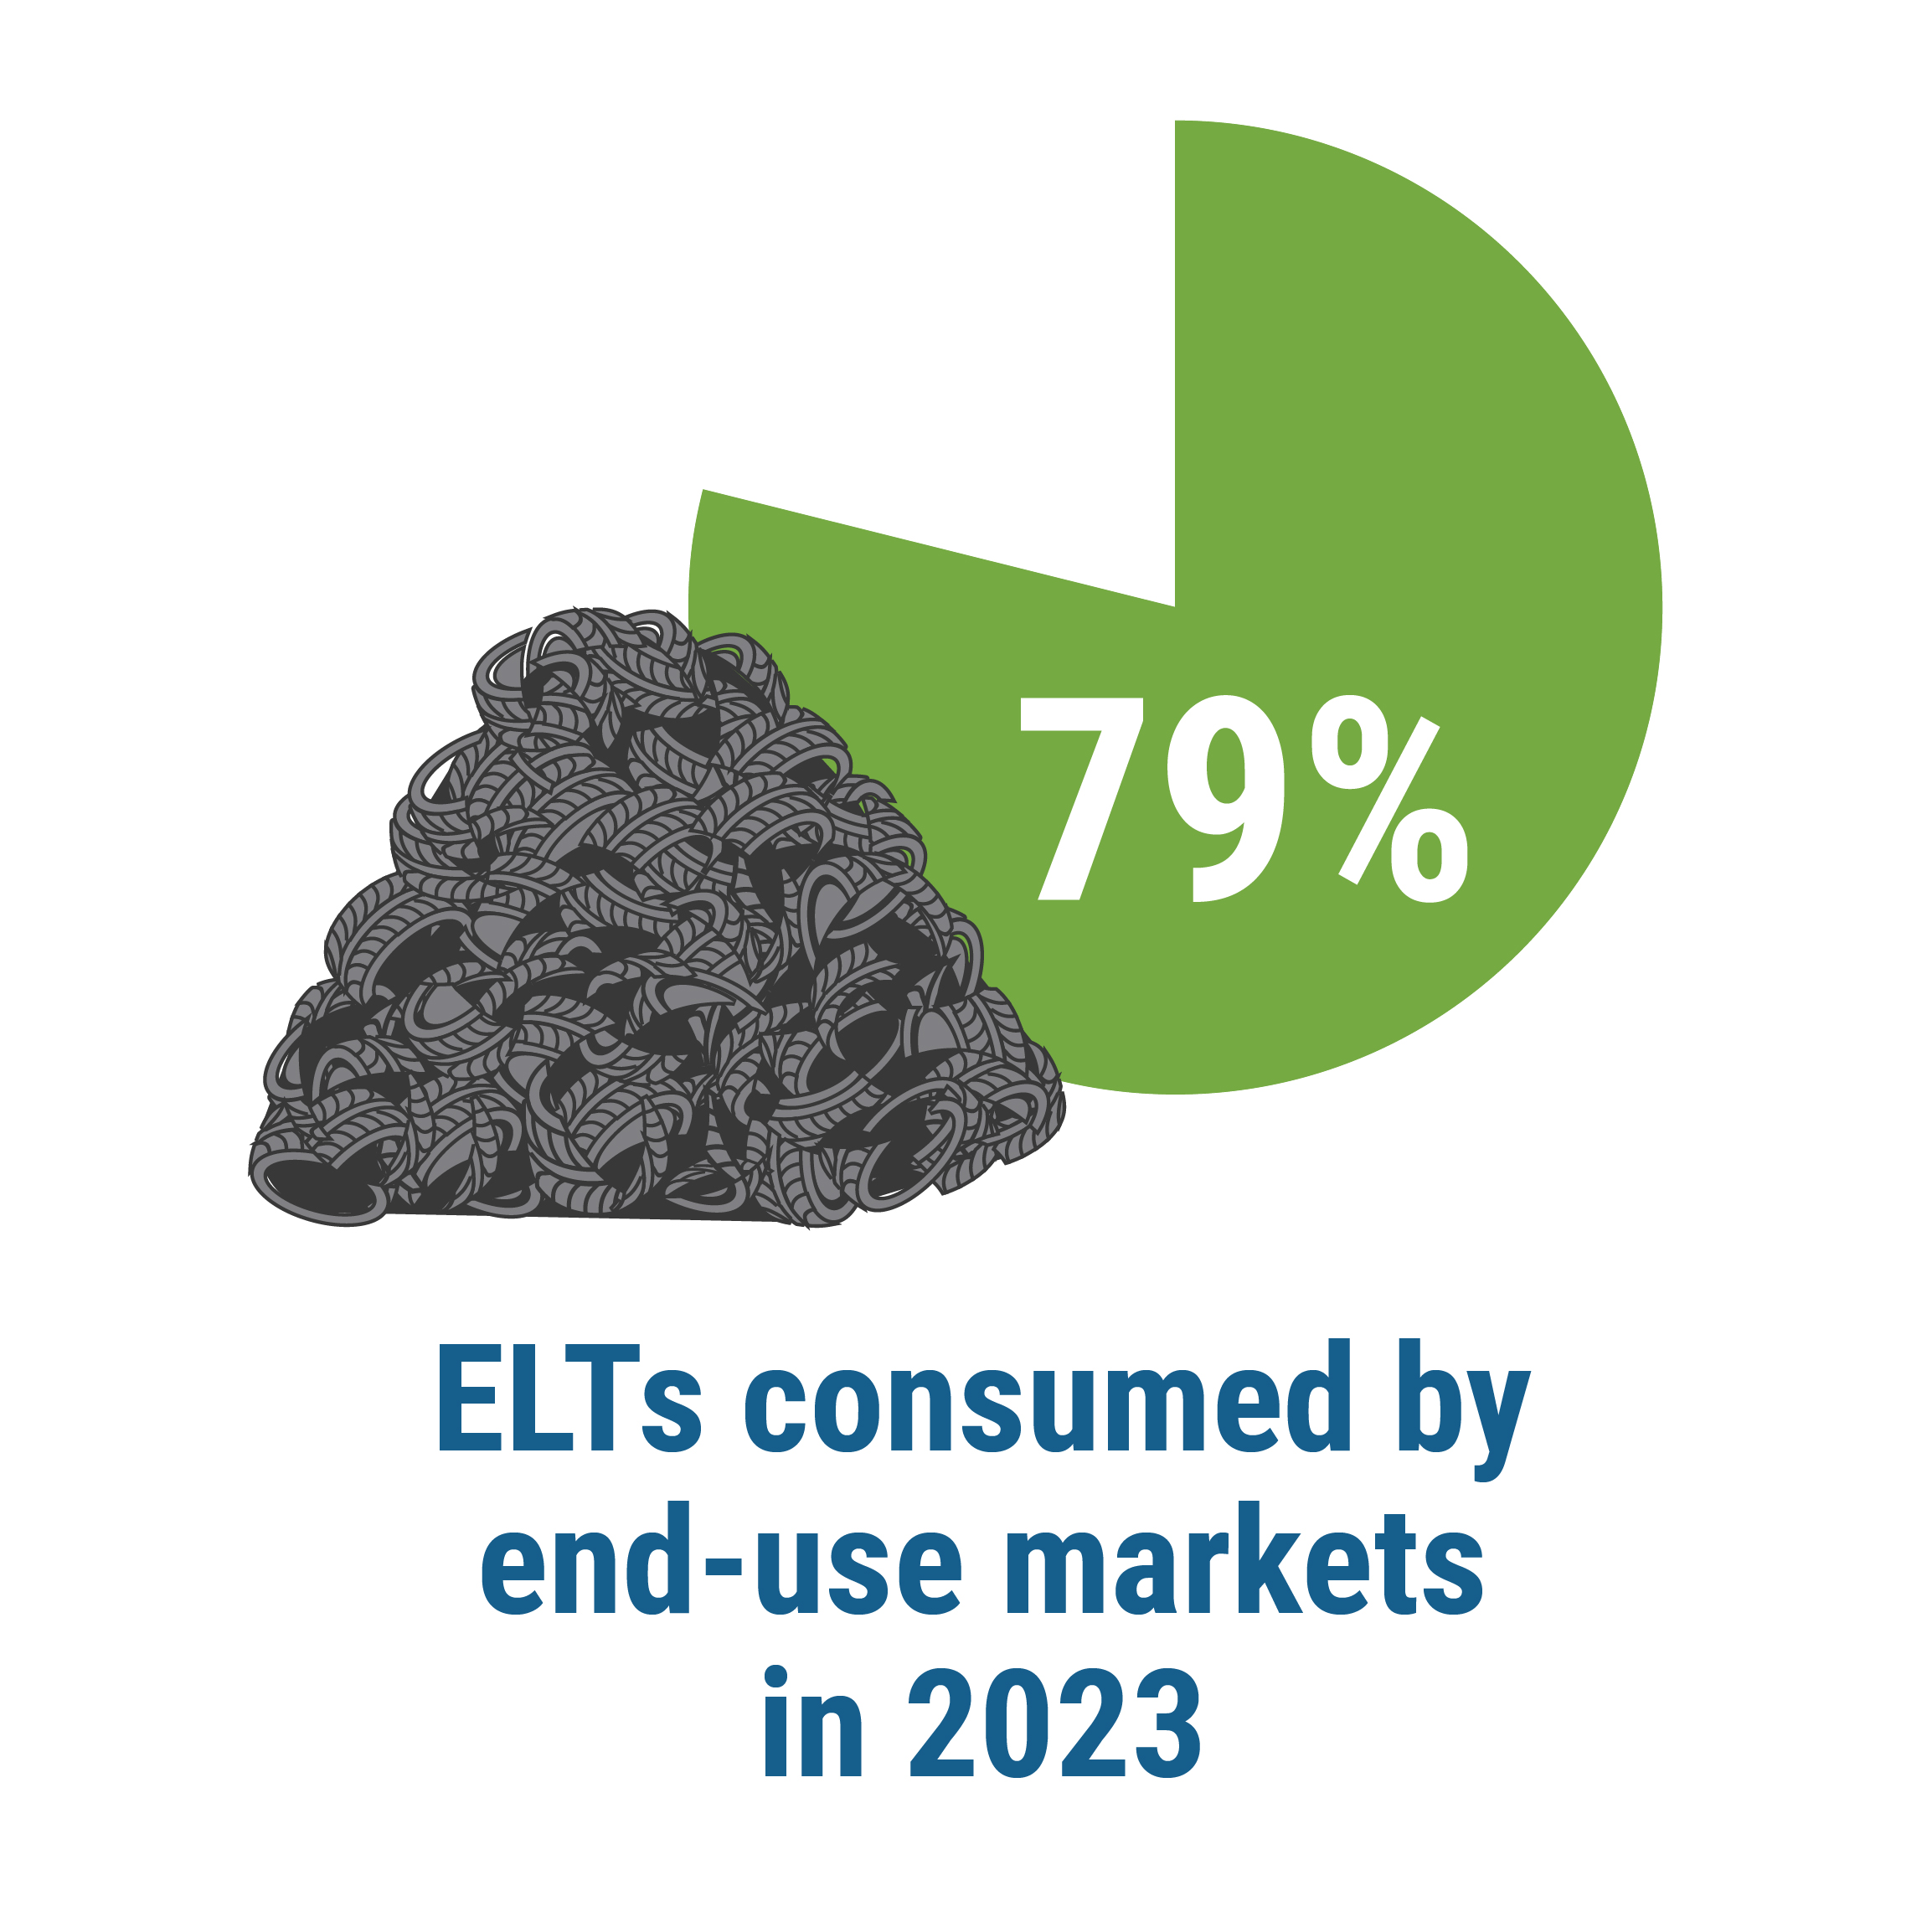
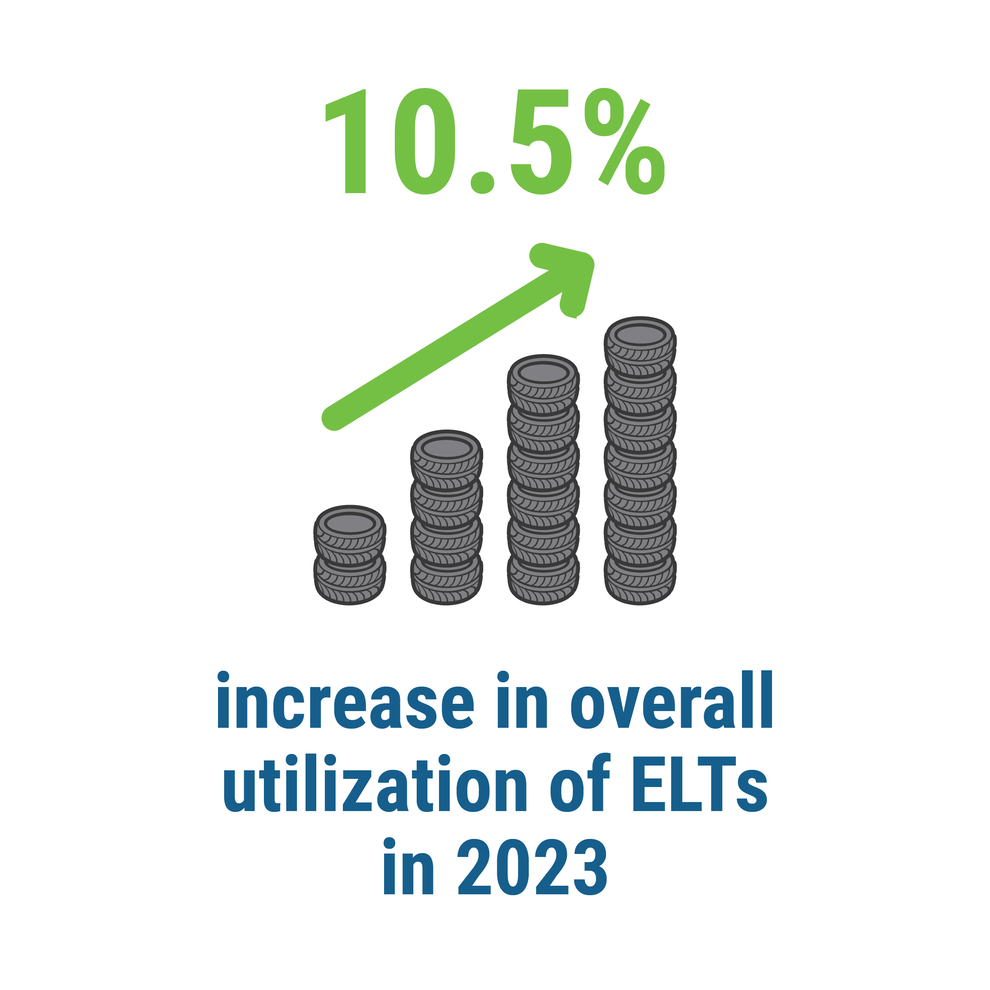
2023 END-OF-LIFE TIRE MARKET SUMMARY
Source: 2023 End-of-Life Tire Management Report

Slide 4
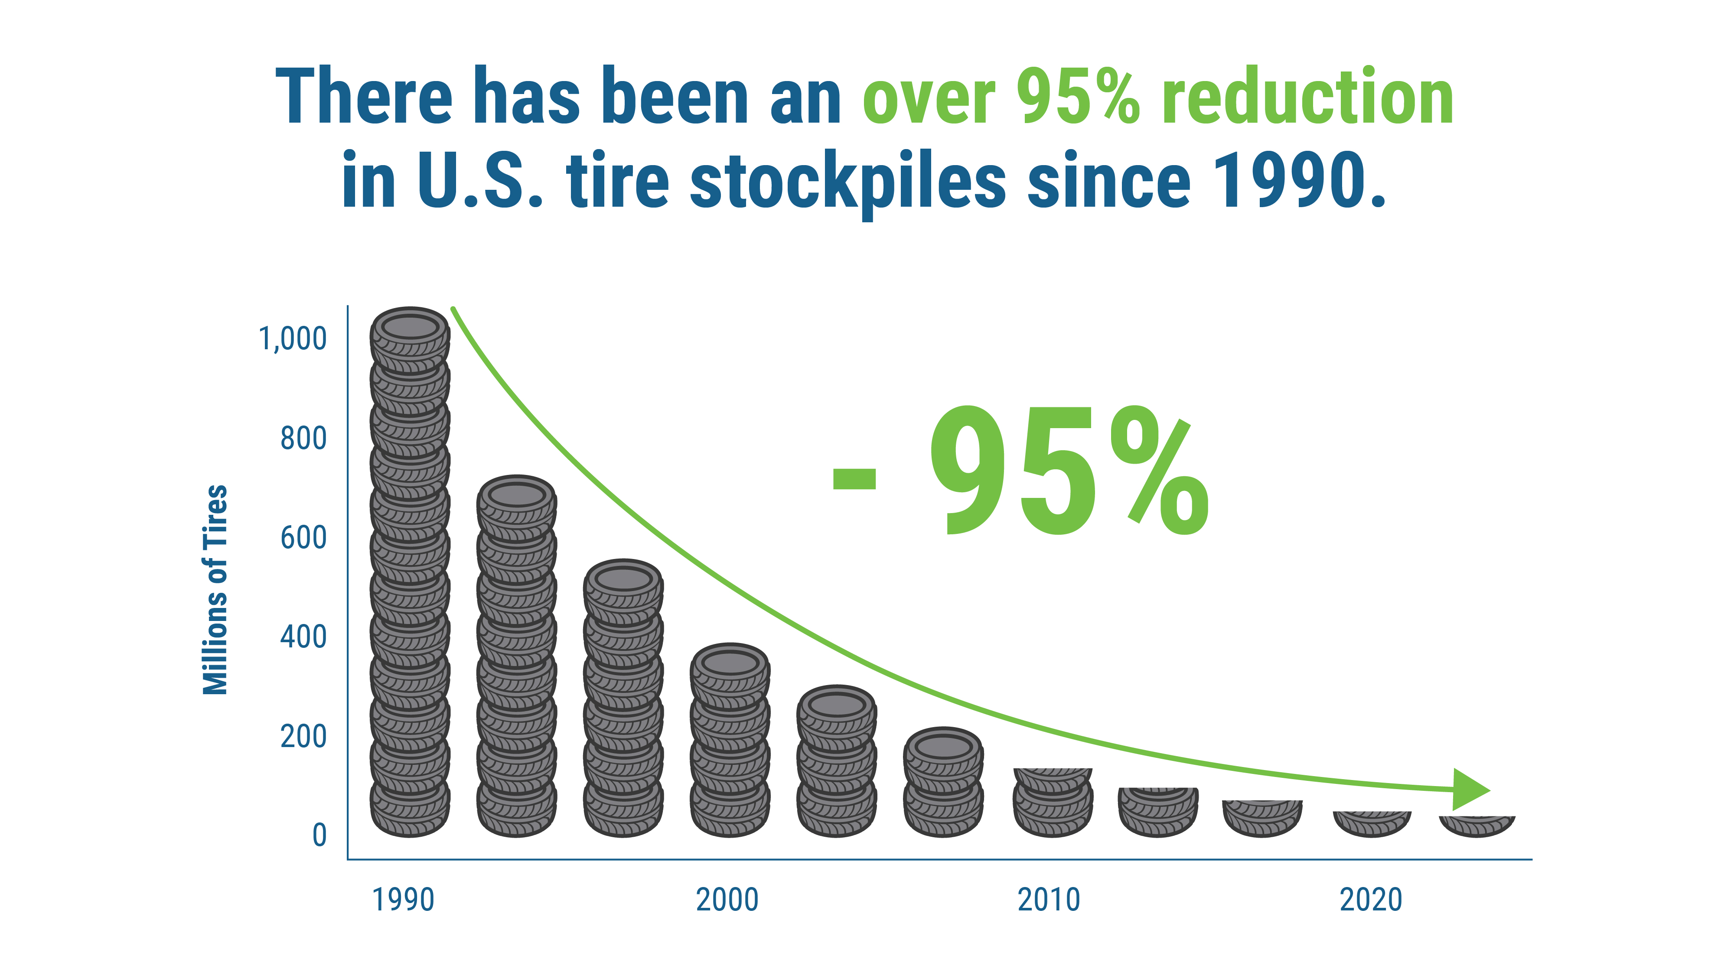
U.S. STOCKPILED END-OF-LIFE TIRES 1990 - 2023
Source: 2023 End-of-Life Tire Management Report

Slide 5
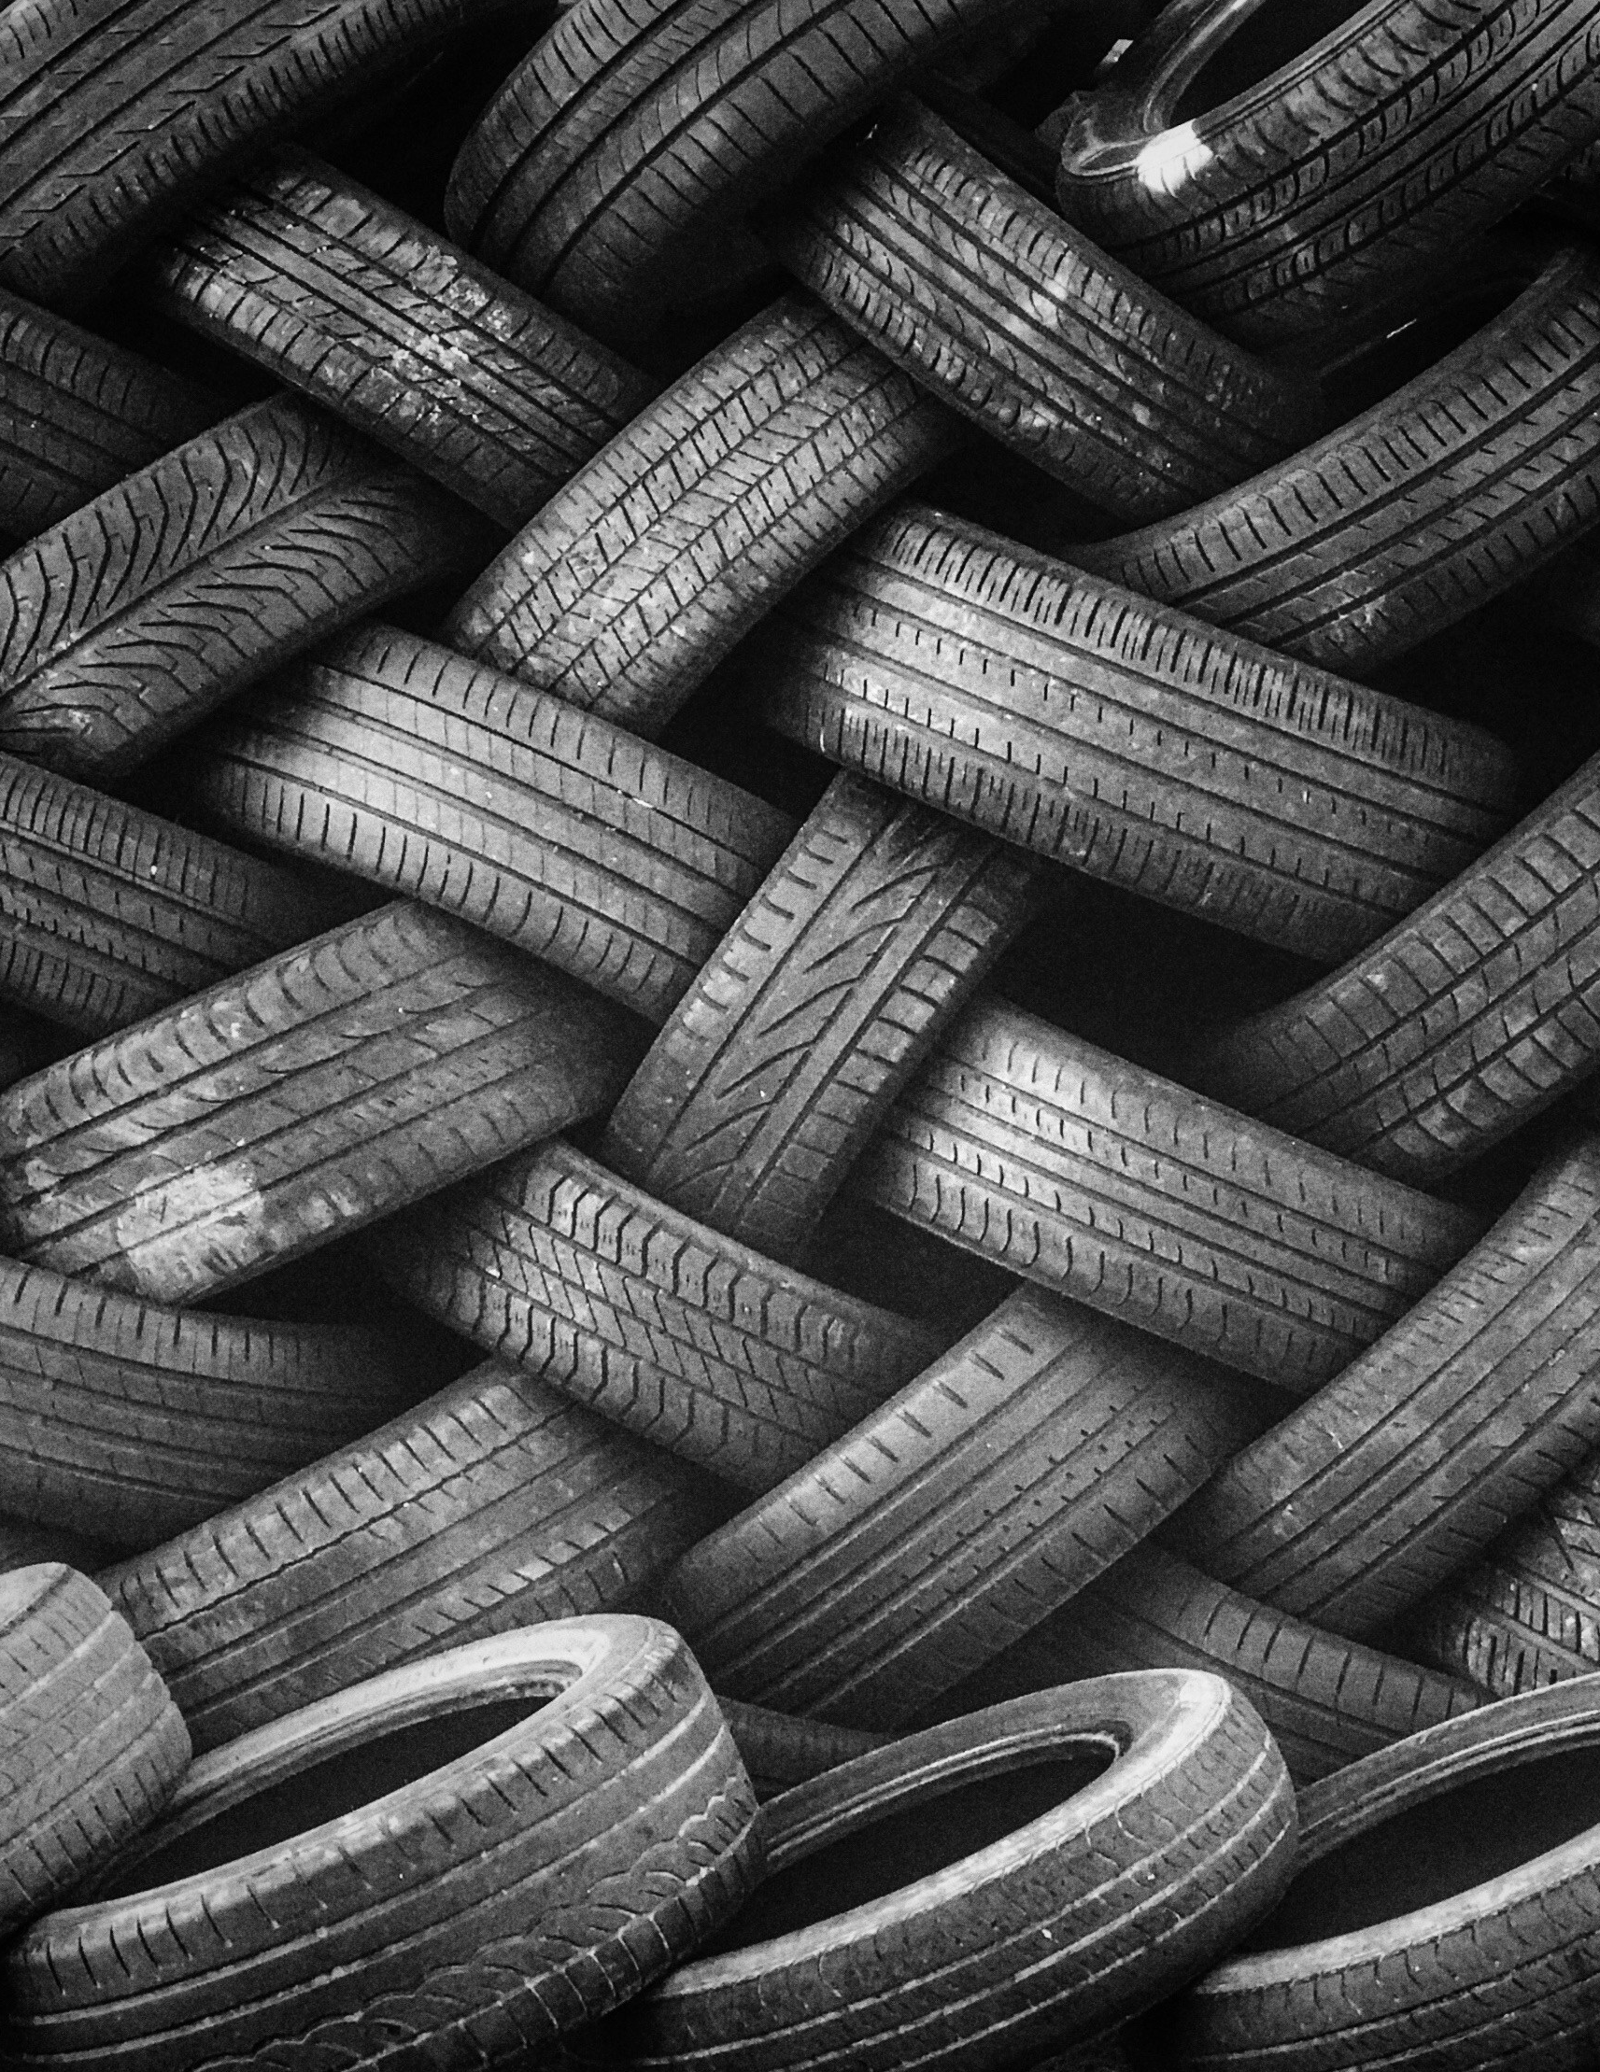
HOW TO ENSURE END-OF-LIFE TIRES ENTER SUSTAINABLE MARKETS
Develop end-of-life tire markets.
Reduce end-of-life tire stockpiles.
Implement state regulations that foster sustainable end-of-life tire markets.
Source: 2023 End-of-Life Tire Management Report

Slide 6
LEARN MORE ABOUT
END-OF-LIFE TIRE MANAGEMENT
ON USTIRES.ORG.

